Slide 1

Note App
made by :-
Doaa Saadeldeen

Slide 2

.
The Note App is an application used
to put your important information in it

Slide 3
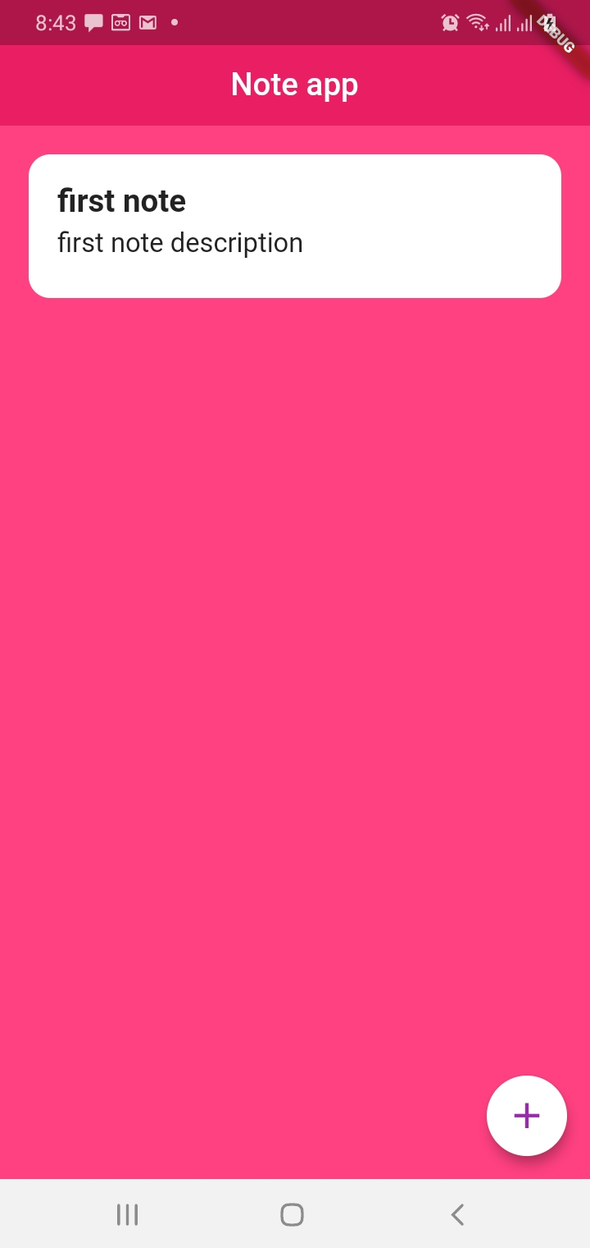
First screen
When application open

Slide 4
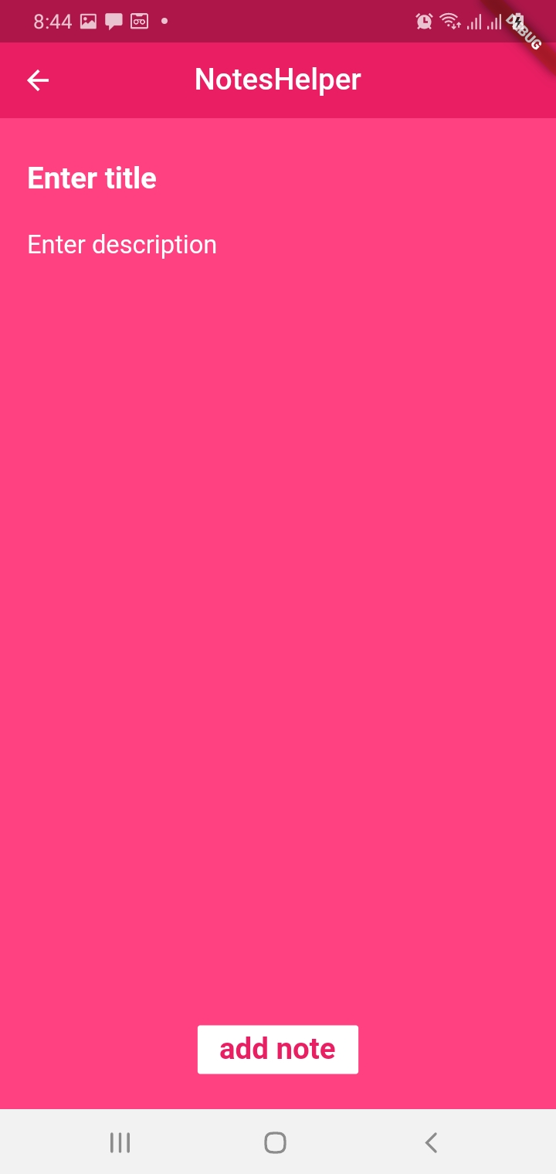
.
To add new note

Slide 5
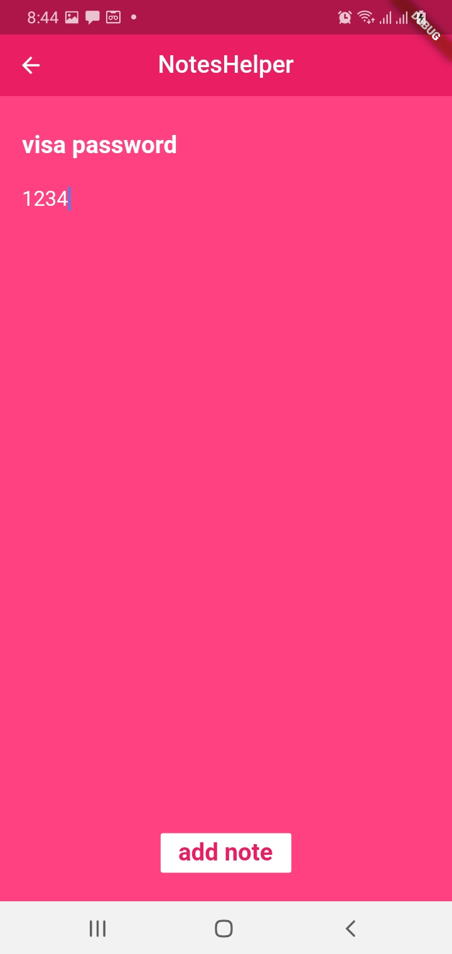
Adding note
.

Slide 6
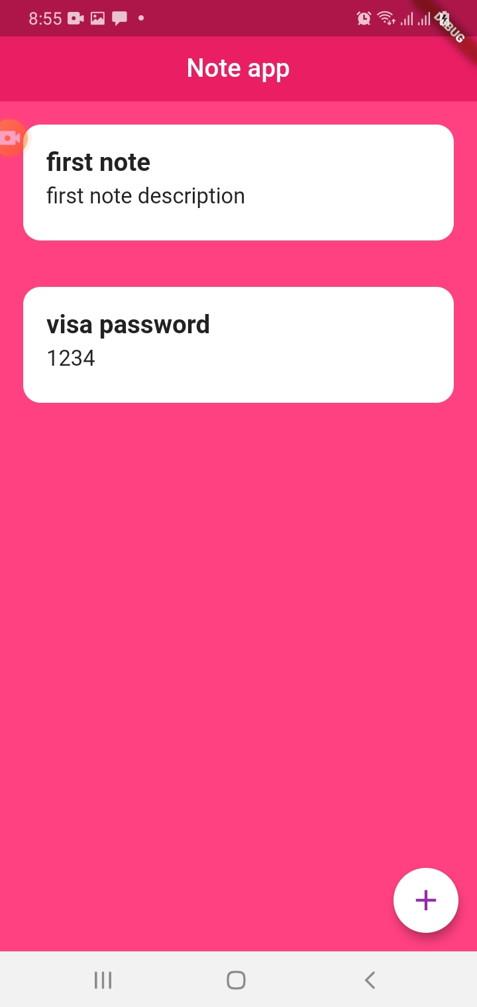
After note added
.

Slide 7
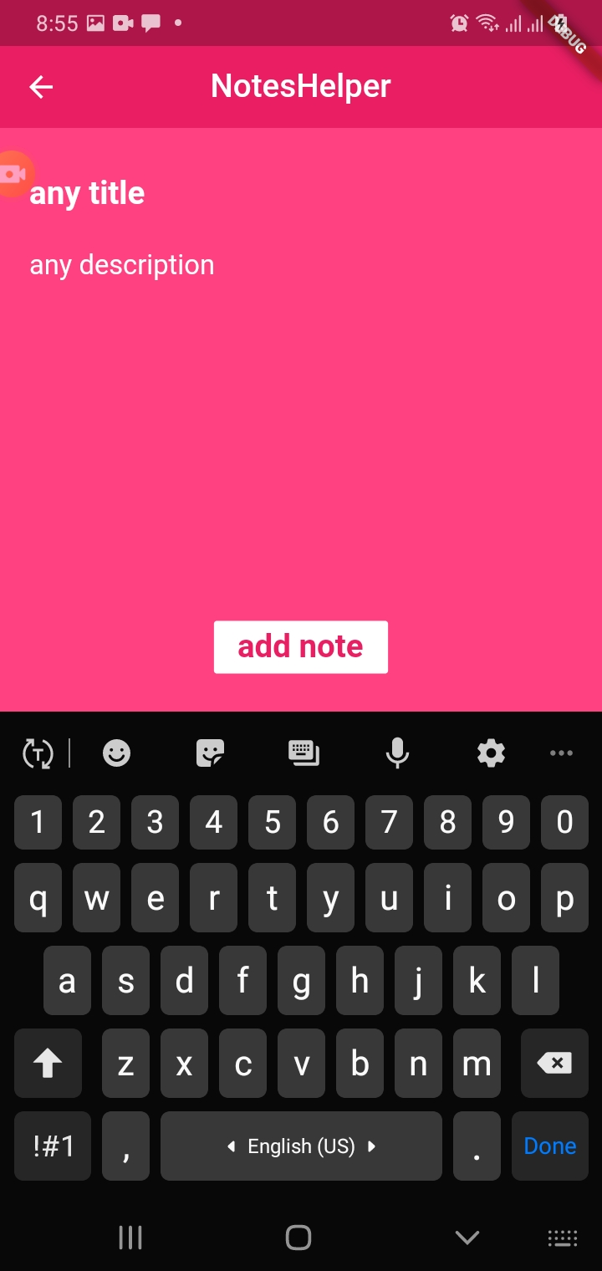
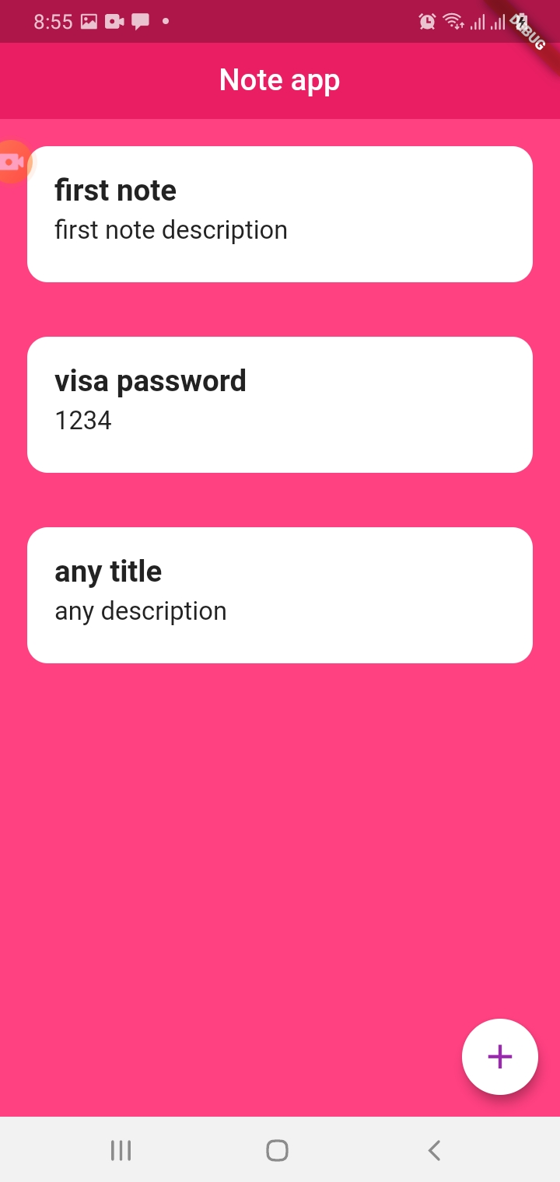
.
Adding another note

Slide 8
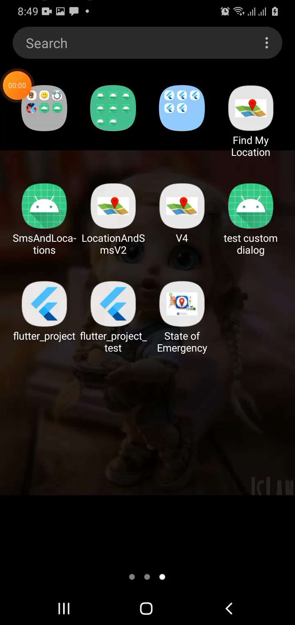
Watch video for app
.

Slide 9
Thanks

